Slide 1
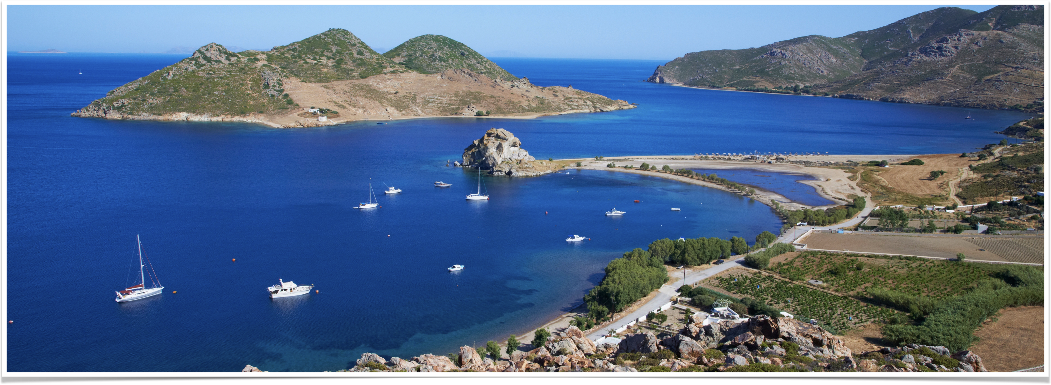
The Revelation of Jesus Christ
Vision 2 , Part 1 (Chapters 4-5)

Slide 2
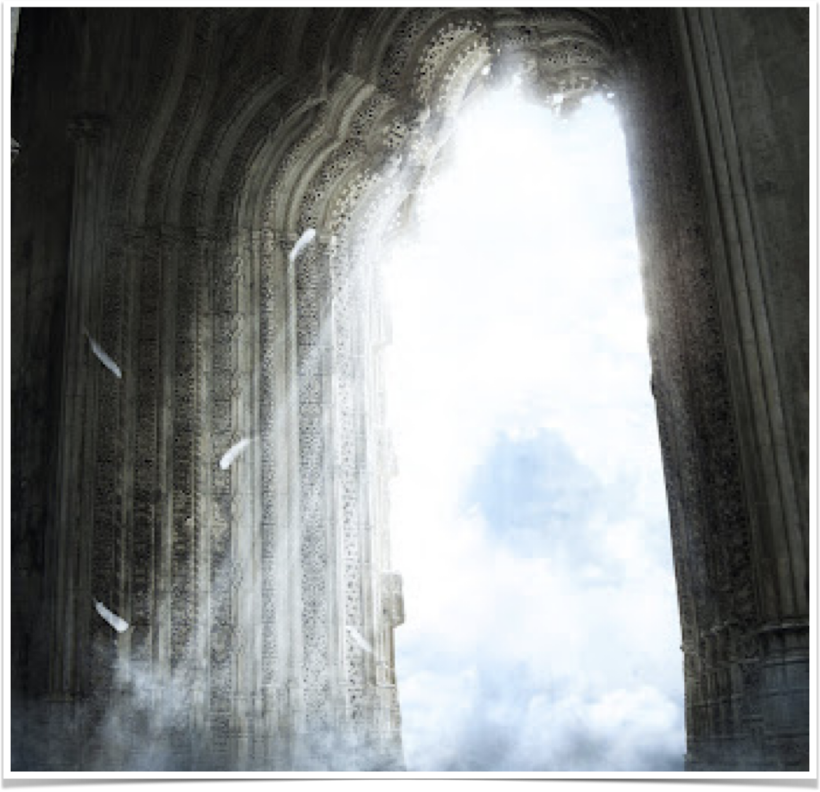
Revelation 4
“After these things I looked, and behold, a door standing open in heaven. And the first voice which I heard was like a trumpet speaking with me, saying, ‘Come up here, and I will show you things which must take place after this.’”

Slide 3
“…a door standing open in heaven”
“…first voice I heard” — the voice of Jesus (see 1:10-11)
“I will show you things…” (see 1:1)
  God to Jesus, Jesus to John
“…things which must take place after this” (remember 1:19)
  4:2 onward concerns future events

Slide 4
John’s vision of God
“…in the Spirit”
Description of God
  Seated on a throne
  “like a jasper and a sardius”
  “rainbow around the throne”
  No description of God’s appearance…

Slide 5
The Twenty-Four Elders
“…clothed in white robes” — see 3:5, 3:18, 6:11, 7:9, and 7:13-14
“…crowns of gold on their heads — see 1:6, 2:10, 5:9-10
24 elders represent the faithful of mankind
Are they angels?

Slide 6
Verse 5
“…lightnings, thunderings and voices” — see Exodus 19:16-18; Revelation 11:19 and 16:17-18
“Seven lamps of fire…seven spirits” = the Holy Spirit
  Zechariah 3:9: “upon the stone are seven eyes”
  Zech. 4:10, “These seven eyes see all which happens upon earth…”
  Rev. 3:2 - Jesus possesses the seven spirits
  Rev. 5:6 - The Lamb has seven eyes which were the seven Spirits of God, “which are....sent out into all the earth” (similar to Zechariah 4:10).

Slide 7
If there is “one [holy] spirit” (Ephesians 4:4, 1 Corinthians 12:12) how can the seven spirits represent the Holy Spirit?

Slide 8
seven “spirits” of Isaiah
Spirit of judgment (4:4) | Spirit of might (11:2)
Spirit of wisdom (11:2) | Spirit of knowledge (11:2)
Spirit of understanding (11:2) | Spirit of the fear of the Lord (11:2)
Spirit of counsel (11:2)

Slide 9
“For He whom God has sent speaks the words of God, for God does not give the Spirit by measure.”
–John 3:34

Slide 10
Verse 6
“…sea of glass, like crystal”
“…four living creatures” = cherubim (see Is. 37:16, Ps. 99:1, 2 Kings 19:15)
Why described them in different ways in different visions?
“…eyes in front and back” = intelligence, enlightenment

Slide 11
Verses 7-8
“lion” – king of the jungle; strength
“calf” – an ox sometimes considered the king of domesticated animals; humility
“face like a man” – holds dominion over the earth; rationality
“flying eagle” – king of the birds; swiftness
Four living creatures “do not rest day or night”

Slide 12
Verses 8-11: Notice the sets of three
Verse 8 — three sets of three
Verse 9 — “glory and honor and thanks”
Verse 10 — “fall down before Him…worship Him…cast their crowns before the throne”
Verse 11 — “glory and honor and power”
Sets of three are common in describing or praising God (compare to 1:8, 11:17)

Slide 13
The Dilemma
5:1
  “Him who sat on the throne” = God the Father
  “…scroll” = what is revealed in the seals and the trumpets
  “…right hand” = highest authority possible
  “…seven seals” - only those with authority can open a seal from a king
But no one is qualified to open the scroll

Slide 14
Problem solved
5:5
  “Lion of the tribe of Judah” — see Genesis 49:9
  “Root of David” — Isaiah 11:1-2
  He “has prevailed”
“seven horns” = symbol of power

Slide 15
The lamb
“…seven eyes” — see 4:5
The “Lion…Root…Lamb”
The Lamb “took the scroll”

Slide 16
“harp and golden bowls full of incense”
“…bowls of incense” = prayers of the saints
“…harps” = songs of the saints
Singing and praying go hand in hand throughout the NT

Slide 17
The twenty four elders (verses 9-10)
“You are worthy to take the scroll and to open its seals”
“For you were slain and have redeemed us to God by Your blood out of every tribe and tongue and people and nation,”
“And have made us kings and priests to our God; and we shall reign on the earth.”
Three couplets sang in praise to the Lamb.

Slide 18
The host of heaven (verse 12)
“Worthy is the Lamb who was slain,”
“To receive power and riches and wisdom,” (three-fold praise)
“and strength and honor and glory and blessing!” (four-fold praise)
A sevenfold praise of the Lamb

Slide 19
All of creation (verse 13)
“And every creature which is in heaven and on the earth and under the earth and such as are in the sea, and all that are in them…” (4 - the number of the earth)
"Blessing and honor and glory and power” (four-fold praise)
“Be to Him who sits on the throne,” (God the Father)
“And to the Lamb, forever and ever!” (Jesus Christ, the Son)

Slide 20
Summary of verses 8-13
Three groups praise the Lamb
  The twenty-four elders
  The host of heaven
  All of creation
The praise consists of various mixtures of three-fold and four-fold praise

Slide 21
“Therefore God also has highly exalted Him and given Him the name which is above every name, that at the name of Jesus every knee should bow, of those in heaven, and of those on earth, and of those under the earth, and that every tongue should confess that Jesus Christ is Lord, to the glory of God the Father.”
– Philippians 2:9-11

